Slide 1
Major Functions
Organizational Structure
Membership Directory
Event Calendar
Organizational Notices
Duty Management
Entity Descriptors
Resource/Reference Repository
Need Awareness

Slide 2
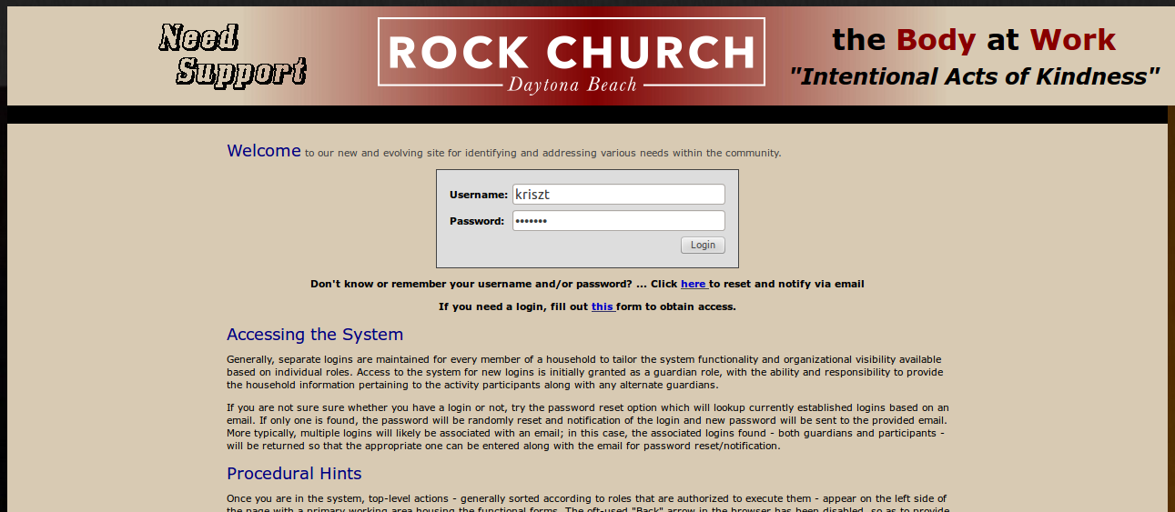
System Access
“Some Link”
https://www.almegaworks.com:8443/ICare?context=ROCKDB

Slide 3
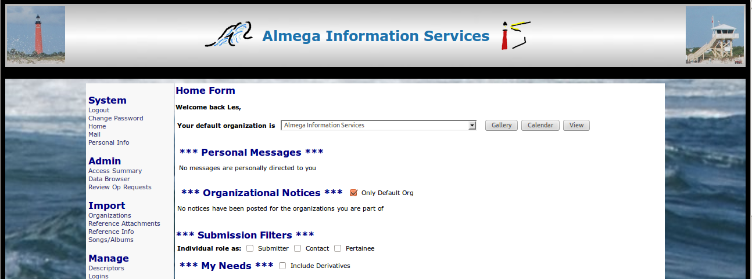
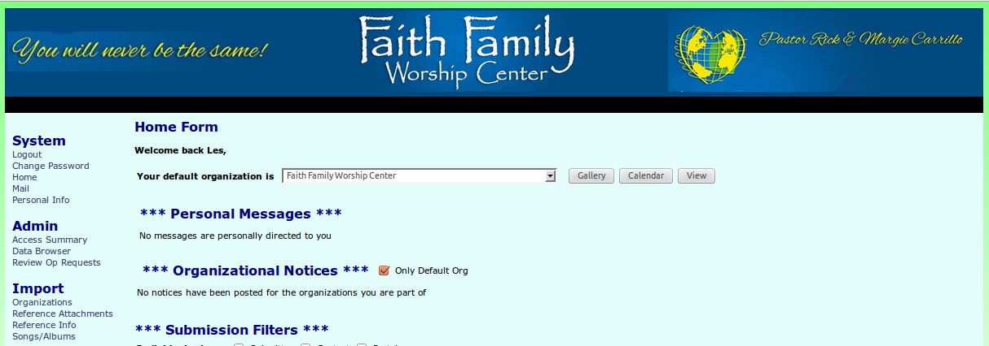
Tailored “Skins”

Slide 4
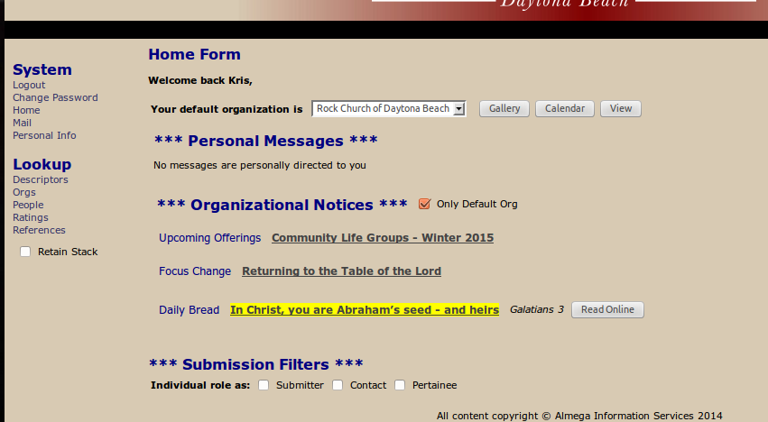
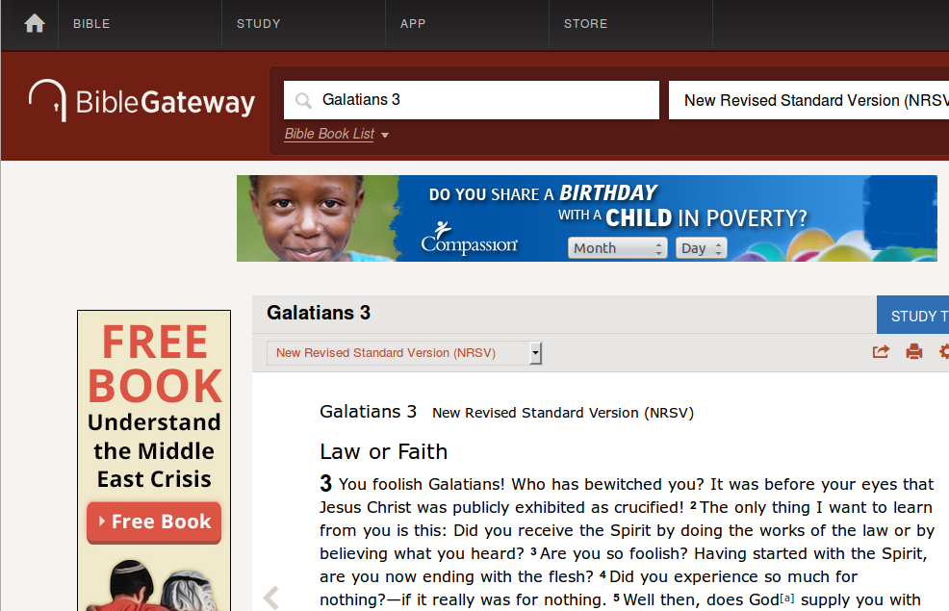
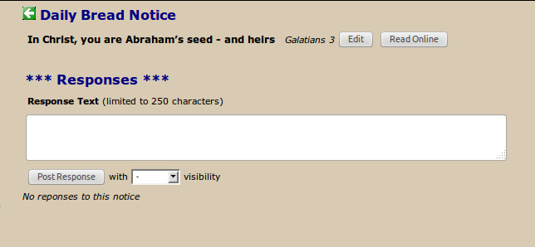
Notice Viewing

Slide 5
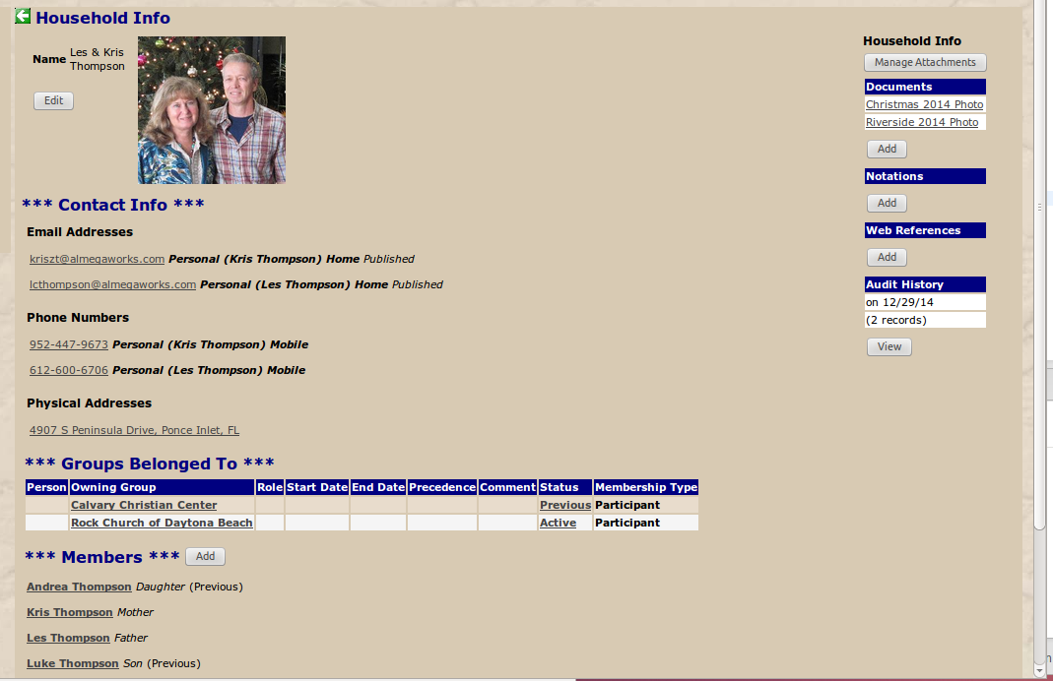
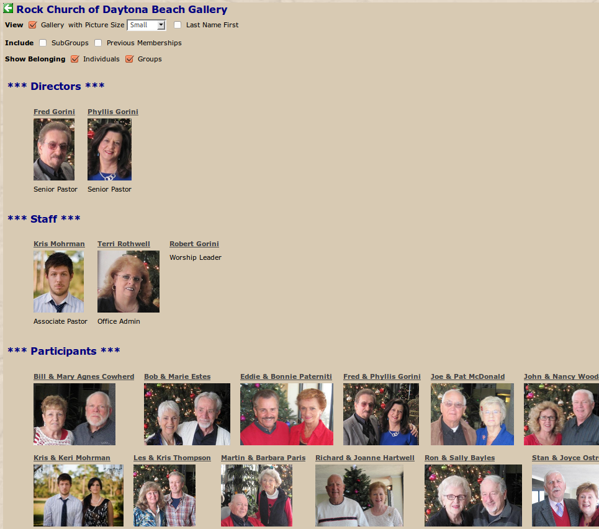
Org Gallery

Slide 6
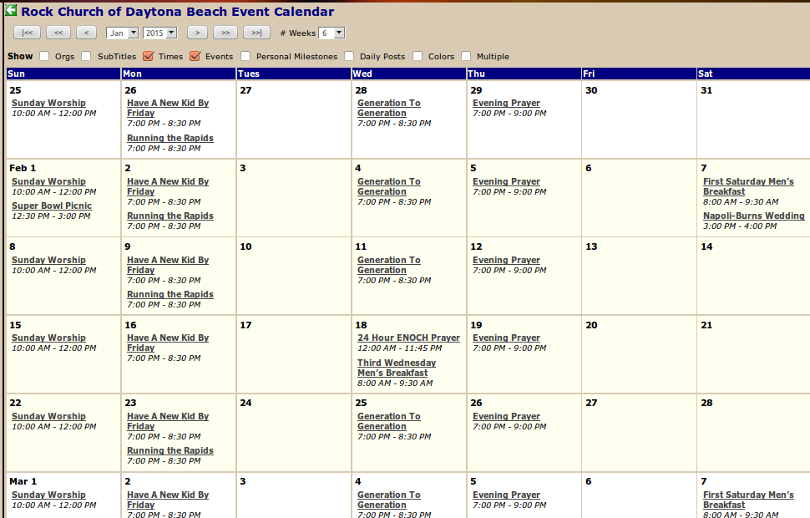
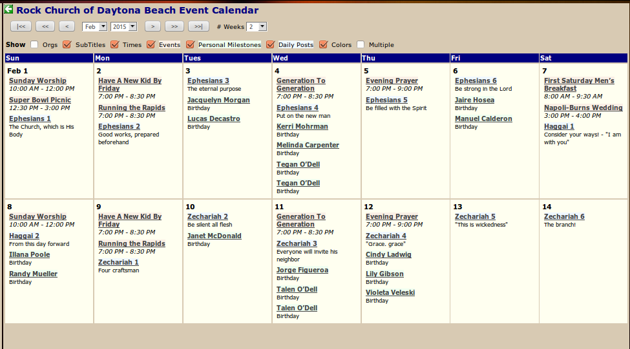
Event Calendar
Filtering Controls

Slide 7
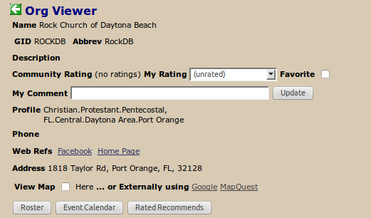
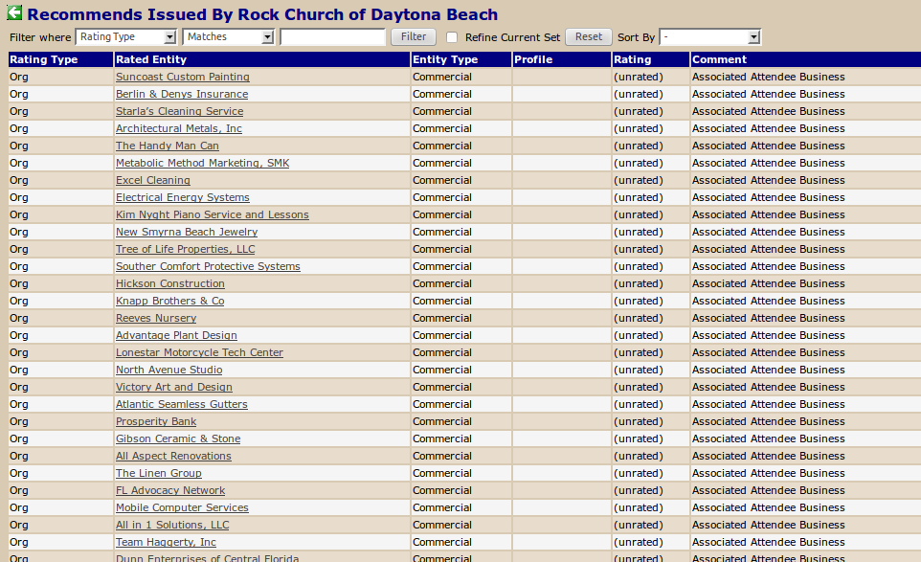
Org (/Reference/Resource) Referral

Slide 8
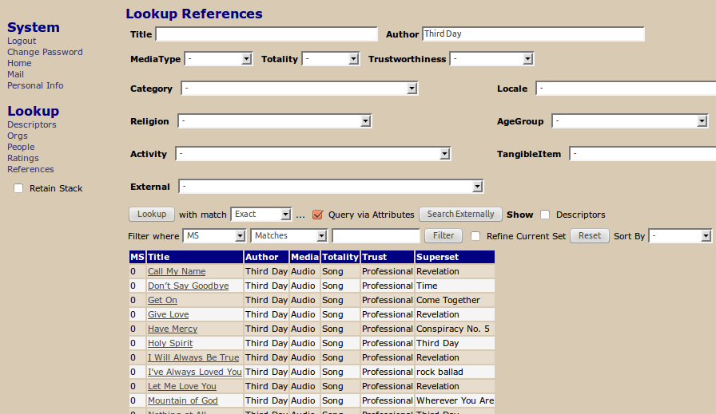
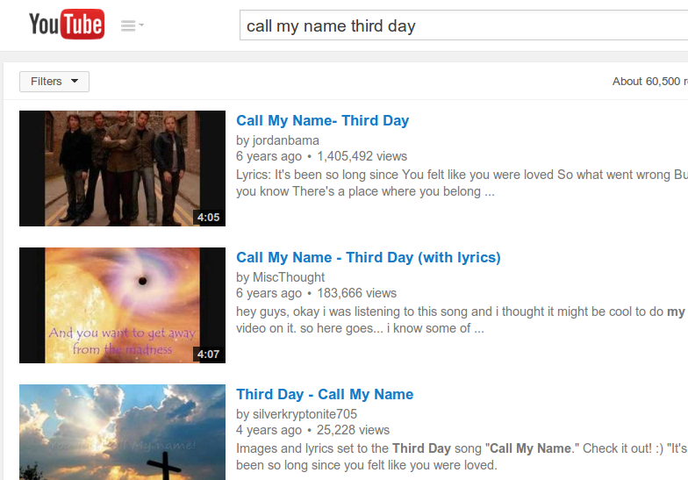
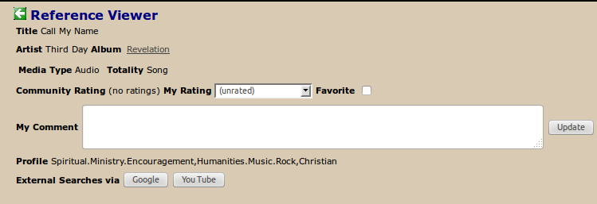
Reference Lookup

Slide 9
Admin Functions
Define Org Structure
Manage Staffing / Membership
Post Notices
Specify Events
...

Slide 10
Admin Functions
Define Org Structure
Manage Staffing / Membership
Post Notices
Specify Events
...

Slide 11
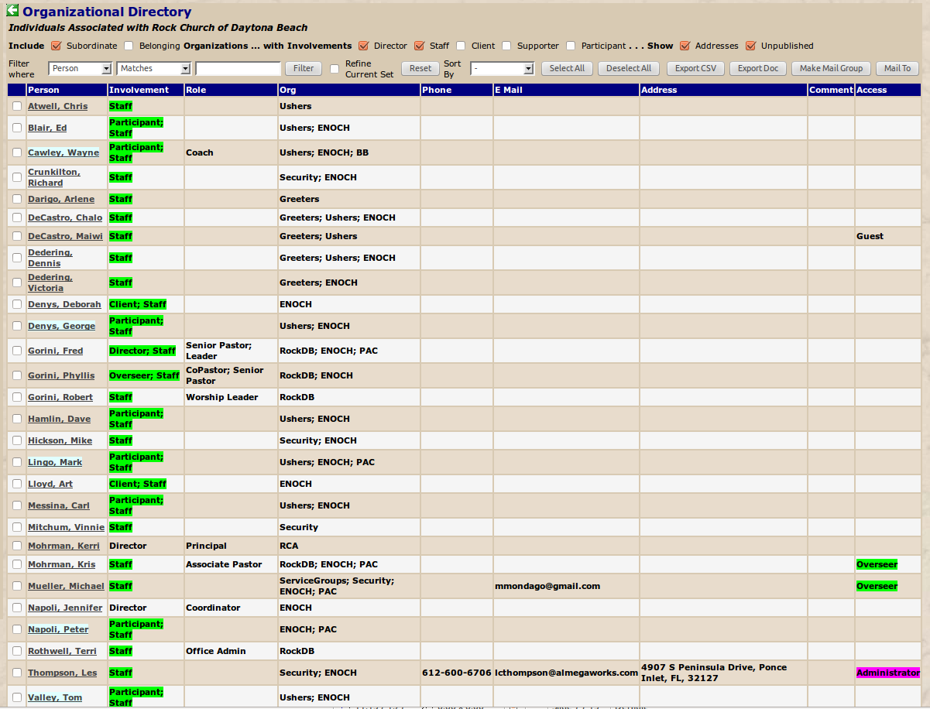
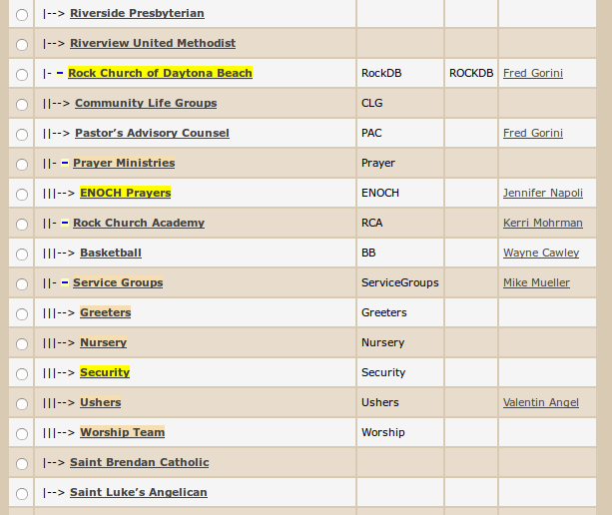
Org Hierarchy/Directory

Slide 12
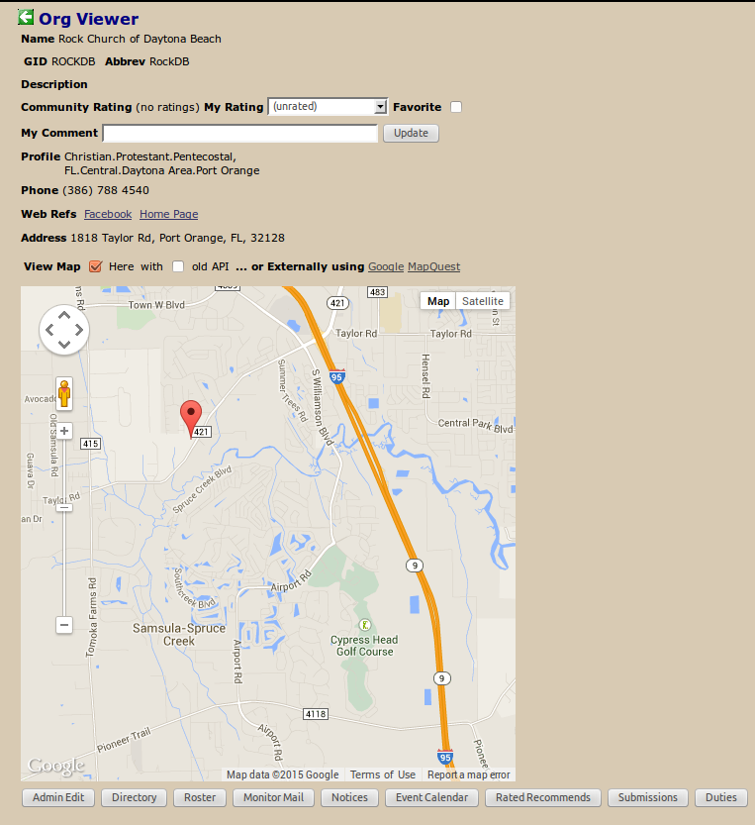
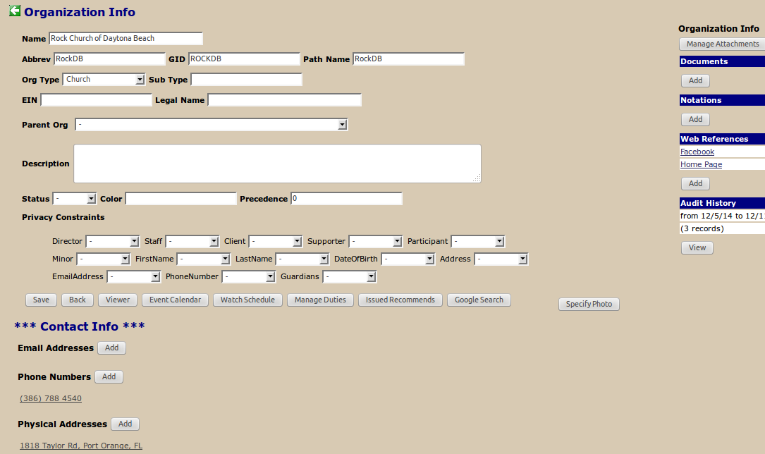
Org Definition

Slide 13
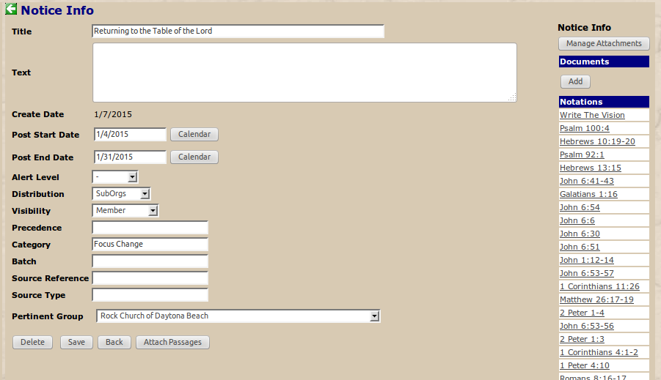
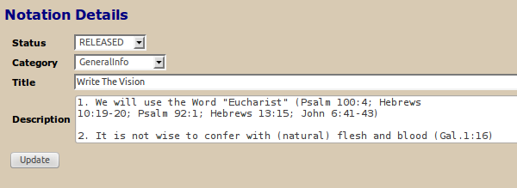
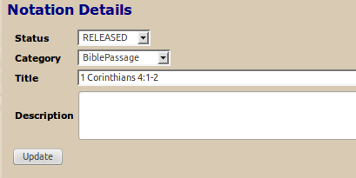
Notice Construction

Slide 14
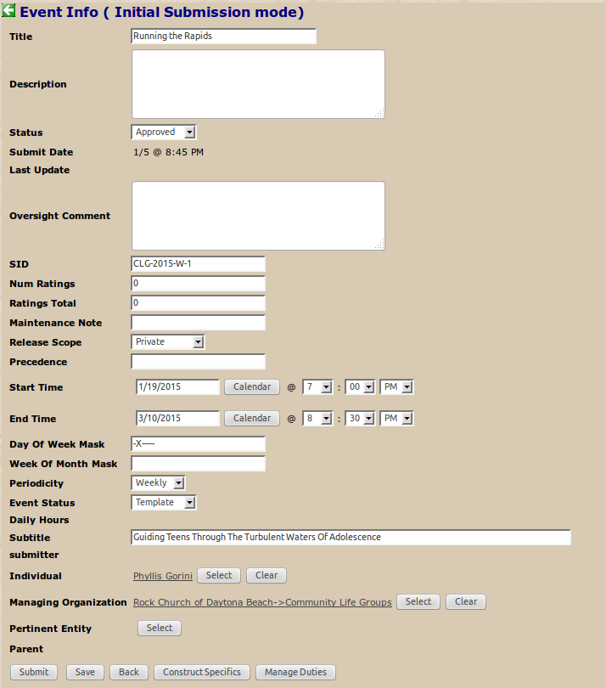
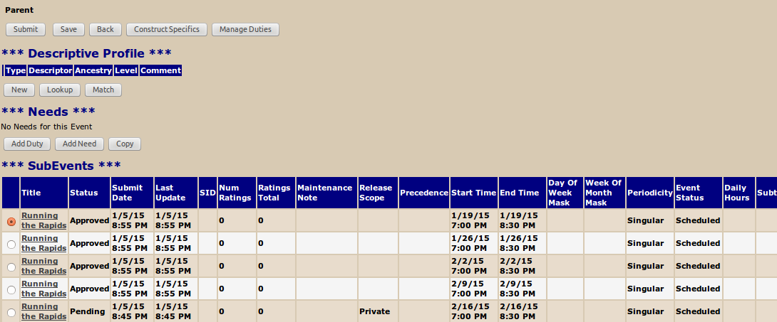
Repeated Event Definition

Slide 15
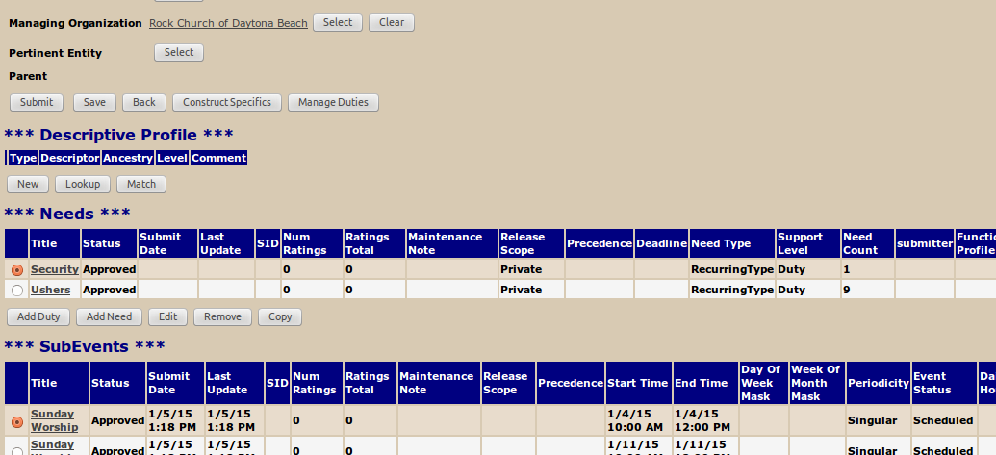
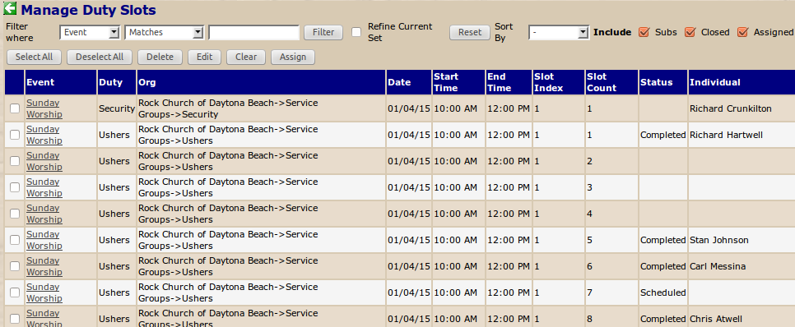
Duty Management

Slide 16
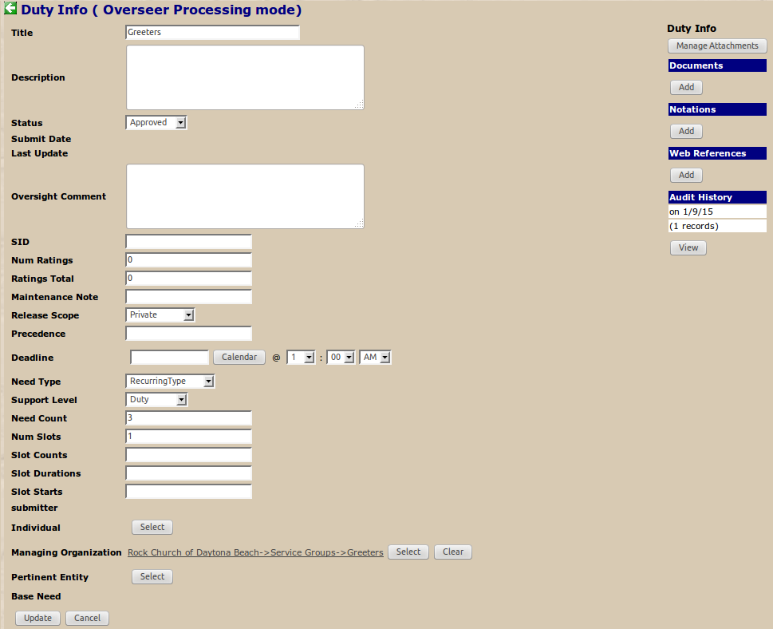
Duty Editing

Slide 17
Adding Participants
Sequence

Slide 18
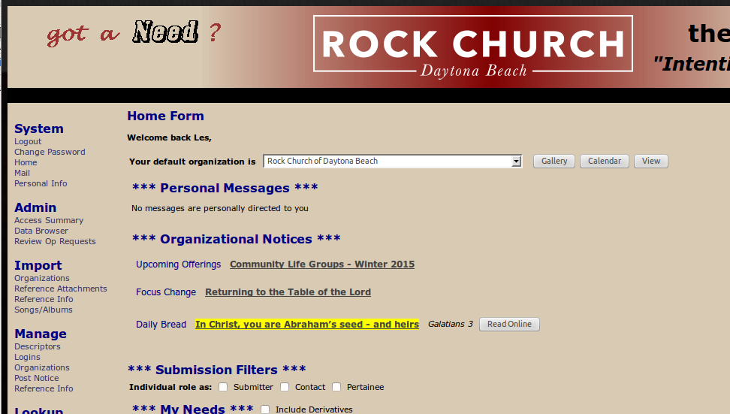
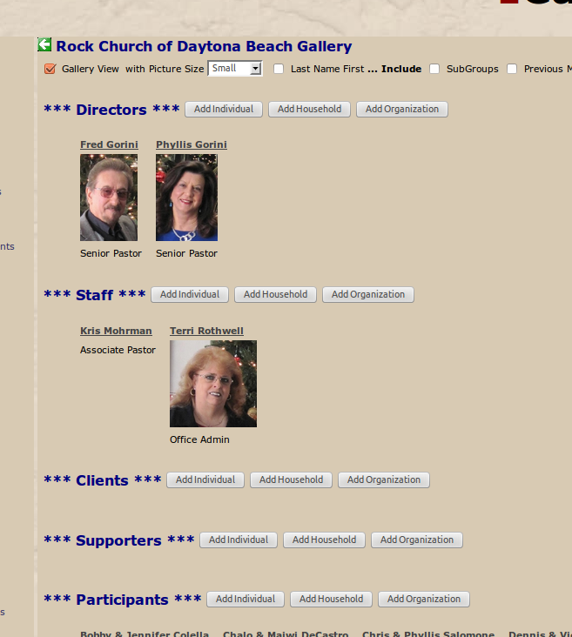

Slide 19
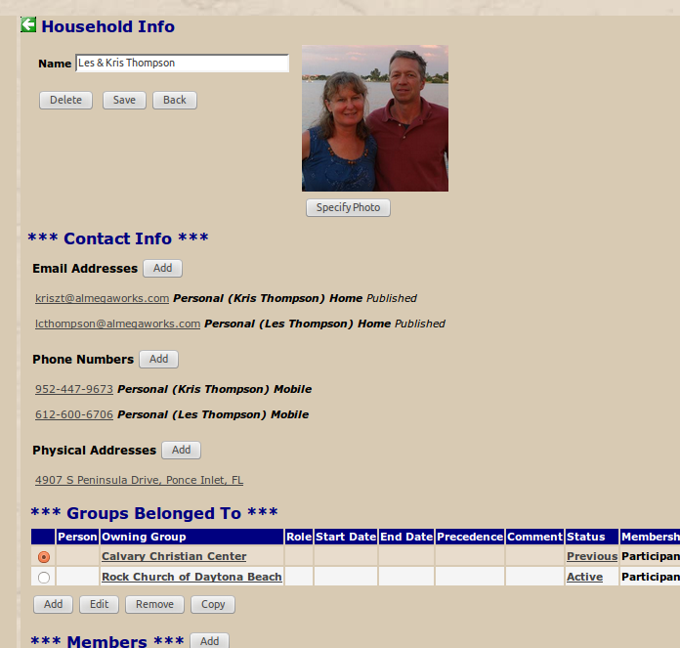
First, see if household already exists:
- enter name and click search
- matches found will be listed
Can then edit if necessary
- check pertinent match
- click Properties button to bring up household editor
If no match found
- click New to construct and edit

Slide 20
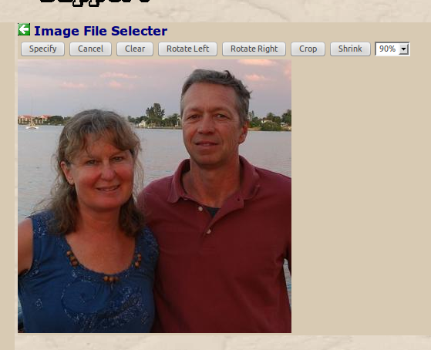
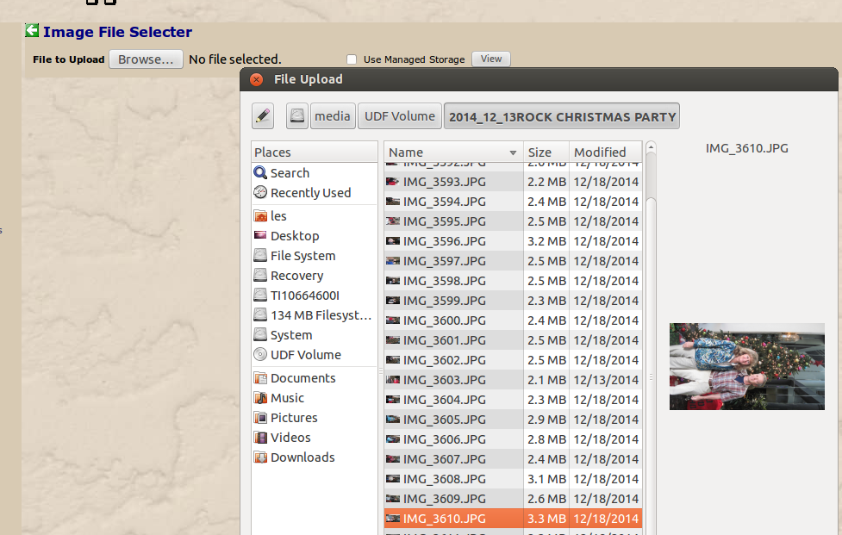
Photo Specification
If changing existing photo, first Clear it
Browse to and select local file

Slide 21
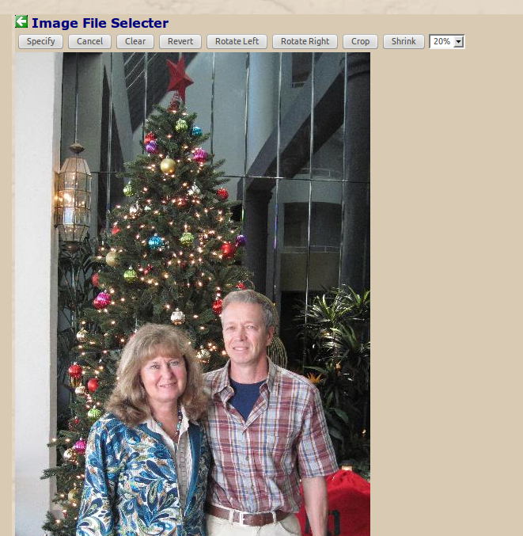
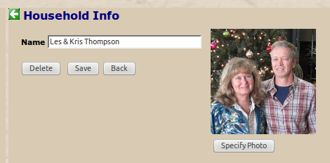
Photo Editing, Saving
Edit image appropriately - iteratively rotating, shrinking, and cropping as necessary
Click Specify to return (edited) image to household editor
Save the household info/photo

Slide 22
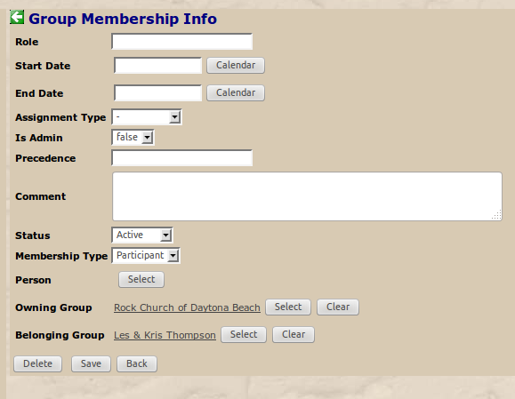
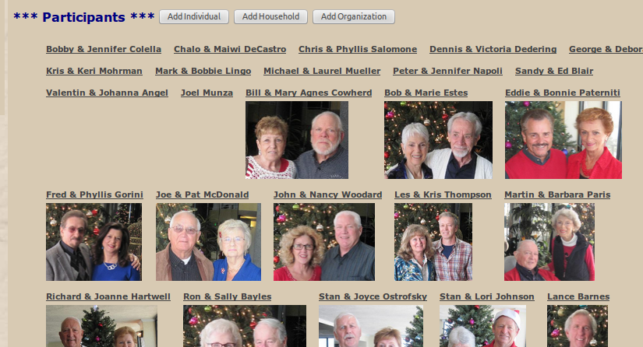
Membership Construction
Click Continue to construct membership for selected household
Edit, if appropriate, the membership information, then Save to return to gallery view

